Slide 1

The Gen Pass Created by: Michael Grant & Amir Andreas
https://github.com/ksu-is/The-Gen-Pass
Generating Password Requirements
The Gen Pass creates random passwords for today’s users.
Do you ever create an account with social media, email, banking, school website?
How many characters are needed?
How are you supposed to remember all the rules for the password?
Original code was created in Visual Studio Code and compiled with other documents to our GetHUB site for presentation.
Introduction

Slide 2
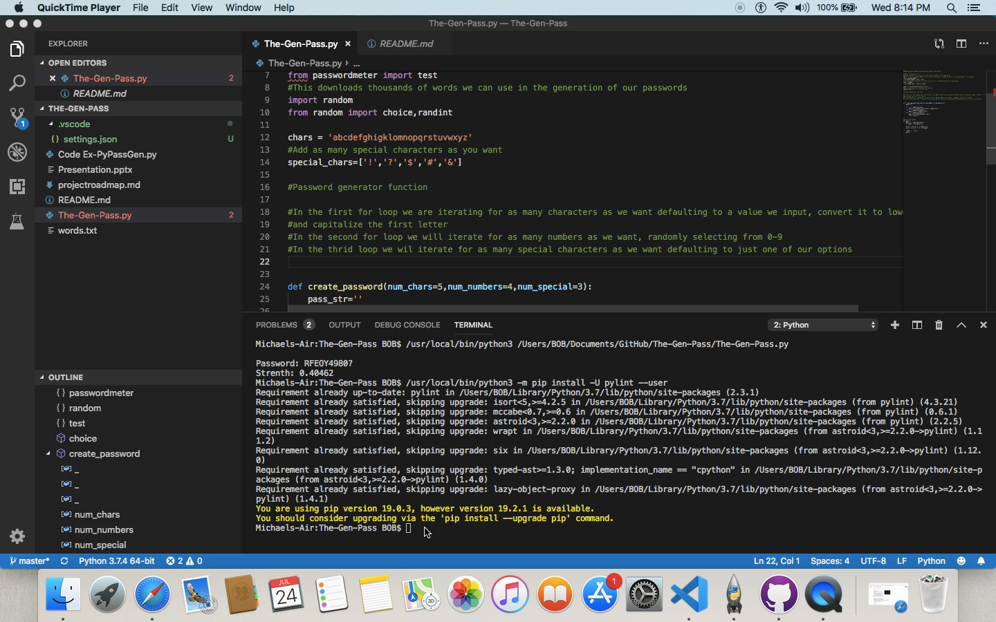

Slide 3
Word.txt
Initially We wanted to import a word text file as a base for the app;
'https://raw.githubusercontent.com/dwyl/english-words/master/words.txt'
Although it loaded fine, we did run into a problem when running it as it would not define certain parameters.
Due to time constraints we were forced to limit it to the letters of the alphabet rather than using word.txt file which would have resulted in unique passwords of a stronger variety

Slide 4
DropBox
One of our initial ideas was to use a dropbox file that would set the parameters of the passwords based on the host.
Integration into the file was an issue and due to an initial problem with word.txt file we could not devote as much time as we wished to.
We certainly feel we could have used better project management tactics to accomplish some if not all our initial goals.
Overall, we are very pleased with application as currently constructed.

